Slide 1
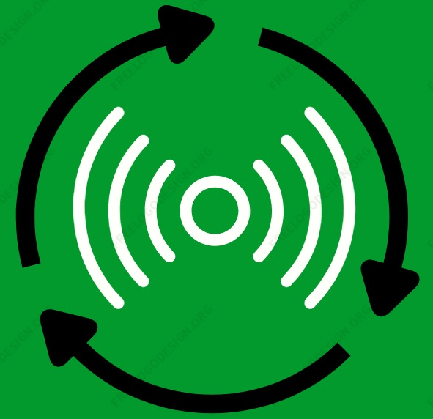

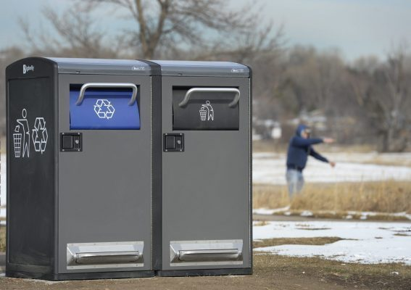



WasteConnect |
Think smart,
Think green.
Search
Home Usage Locations Incentives Feedback Sign up/Login
Smart Technology
Green and Clean
We, WasteConnect are an organization that tries to connect the idea of IOT with the concept of wastes and recycling. The main aim of this organization is:
the user about the usage of the smart bins
To show the user the locations of the near smart bins
To motivate and encourage people to improve recycling incentives
This reduces waste collection by up to 85%.

Slide 2
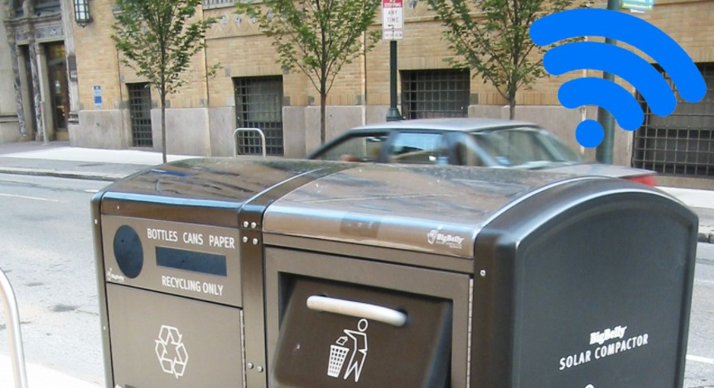





The Advantages of WasteConnect:
To improve the quality of Air and Water as well as reduces greenhouse effects.
Minimize the extraction of resources
Financial benefit for the user
Key Sites
Nigles Eco star
Global renewables
Impact Solutions
Contact us
Senedabraham927@gmail.com
Terms and Conditions
Privacy Policy
Copyright © 2021
WasteConnect

